Slide 1

INFO 7374 MACHINE LEARNING IN FINANCE
Service Now
Stock Analysis and Trading Strategy Model
Team:
Rhea Bajpai
Aniket Mirajkar
Mandar Deshmukh
Abhishek Badhe
Rituja Lolam
Simran Nagpurkar
Under Supervision :
Professor Yizhen Zhao

Slide 2
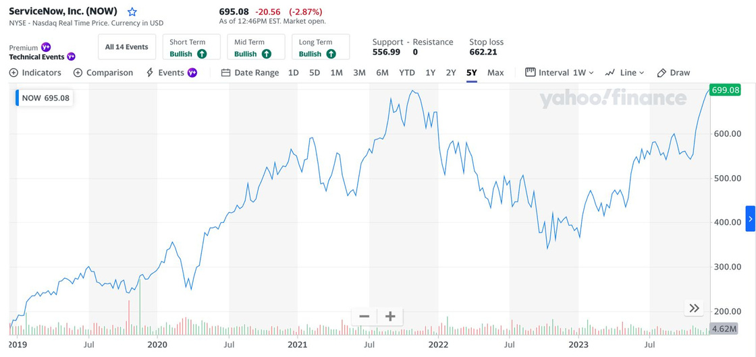

Background
ServiceNow, founded by Fred Luddy in 2004 is a leading cloud-based platform offering IT service management (ITSM) and business process automation (BPA) solutions.
The company's first product, IT Service Management Suite, was released in 2005, marking the beginning of its journey.
Over the years, ServiceNow expanded its offerings beyond ITSM to include various business processes.
The company went public in 2012 with a successful IPO, and its platform gained popularity across diverse industries.
ServiceNow Stock Price (July 2019 - July 2023):
Significant growth: Up from $300 to $695 per share (+130%)
Upward trend: Investors see ServiceNow as a growing company
Volatile price: Peaks & dips, reaching $770 then $530 per share
Overall good investment: Positive performance over the past 5 years

Slide 3
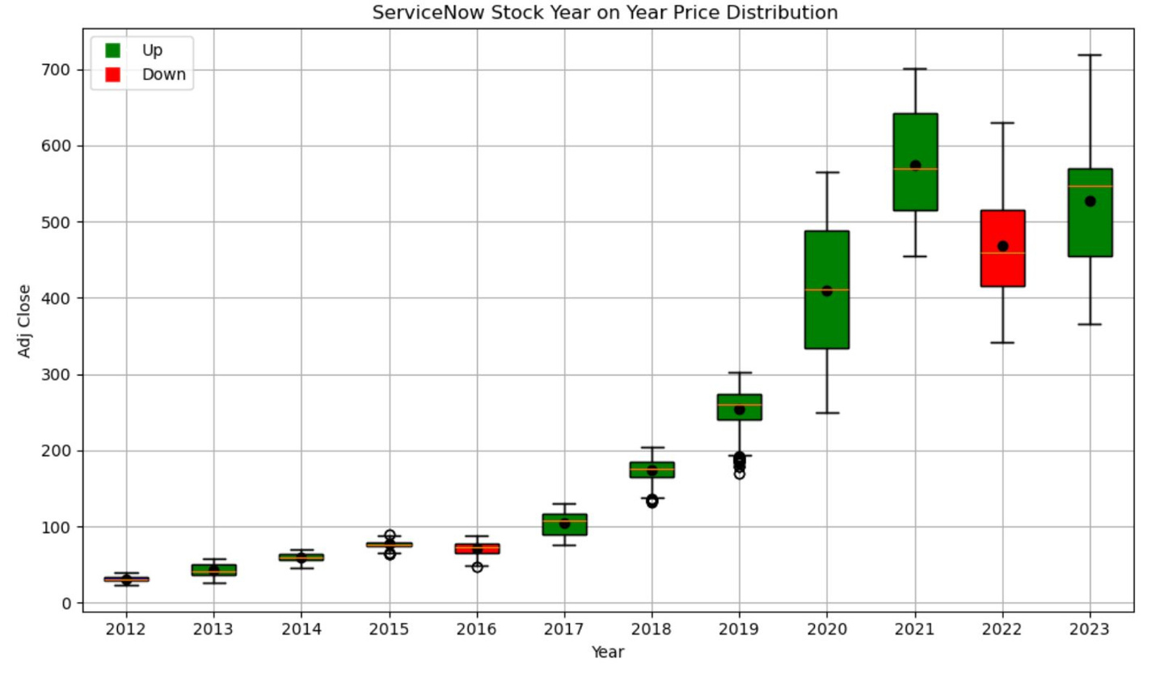
Stock History Journey
ServiceNow's stock price has been volatile over the past 11 years, with a range of highs and lows.
The median stock price has generally increased over time, but there have been some significant year-to-year declines, such as in 2022.
The distribution of the stock price has also become more spread out in recent years, as indicated by the wider boxes and whiskers.
The year 2020 had the highest median stock price, followed by 2021 and 2019.
The year 2022 had the lowest median stock price, followed by 2015 and 2014.
Notes:
The chart is a box plot visualizing ServiceNow's annual stock price variations. Green indicates years with a price increase; red signifies a decrease. The trend shows general growth in stock value over time.

Slide 4
To assess the price dynamics of Service Now stock over the period of 8 years(2015-2023) using visualizations
Overview
Using various features/factors to construct a feature database,Virtualize the feature importance and feature selection, Proposed and train 6 models to get Error Metrics
Develop a trading strategy to make Service Now a valuable offering

Slide 5
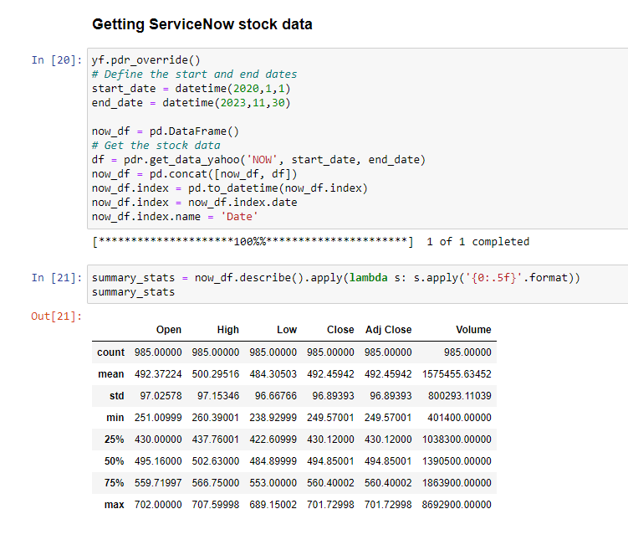
Exploratory Data Analysis

Slide 6
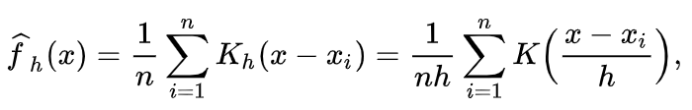
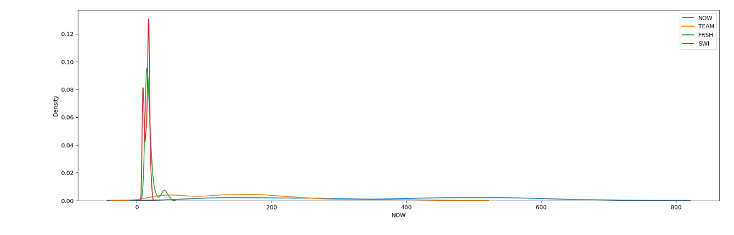
Kernel Density Estimation (KDE)
Non parametric approach for estimating the probability density function of a continous random variable.
Let (x1, x2, ..., xn) be independent sample , density - ƒ at any given point x Where K = Kernel (non negative function)and h> 0

Slide 7
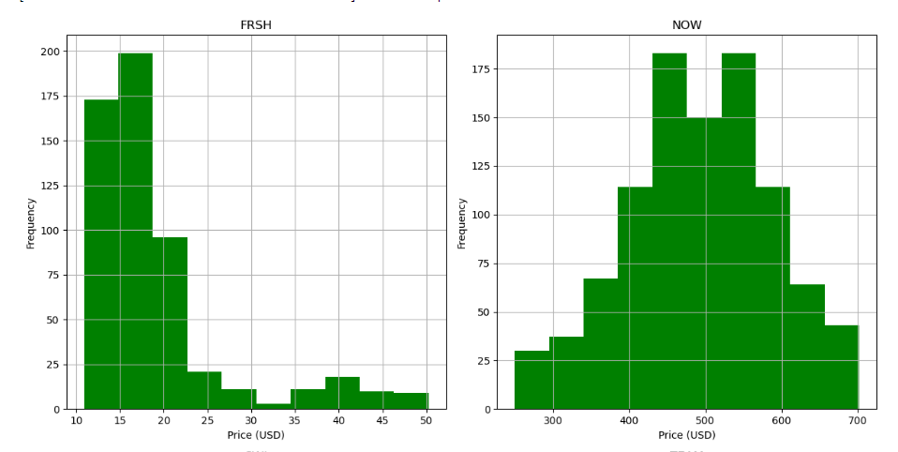
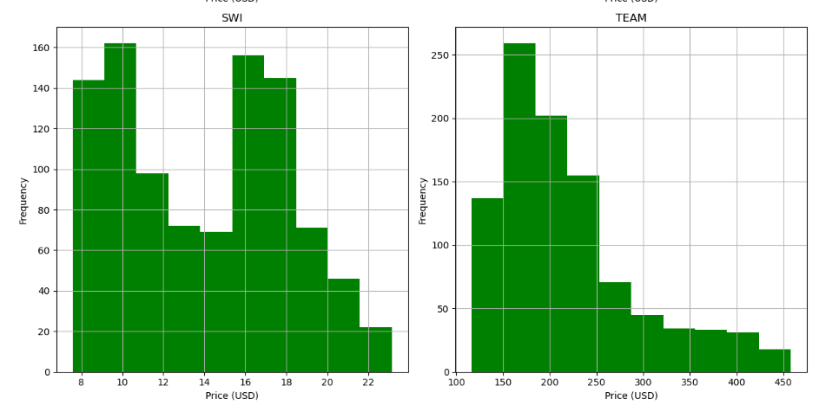
Distribution of adjusted closing prices for four stocks: NOW, TEAM, FRSH, and SWI.

Slide 8
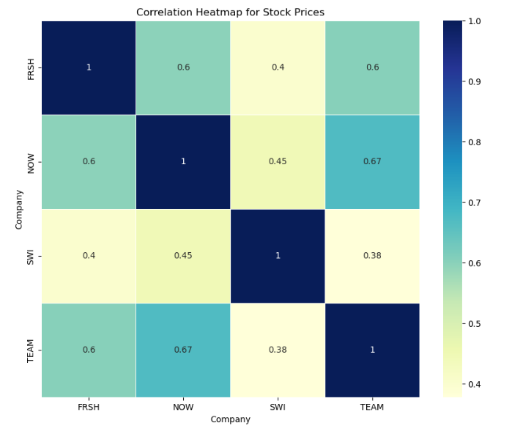
Heat Map
A correlation coefficient of +1 indicates a perfect positive correlation (as one variable increases, the other also increases).
A correlation coefficient of -1 indicates a perfect negative correlation (as one variable increases, the other decreases).
A correlation coefficient of 0 indicates no linear relationship between the variables.
NOW and SWI have the lowest positive correlation i.e 0.45
NOW and TEAM have stronger positive correlation.
Overall, the heatmap shows that there is a positive correlation between the closing prices of these 4 stocks

Slide 9
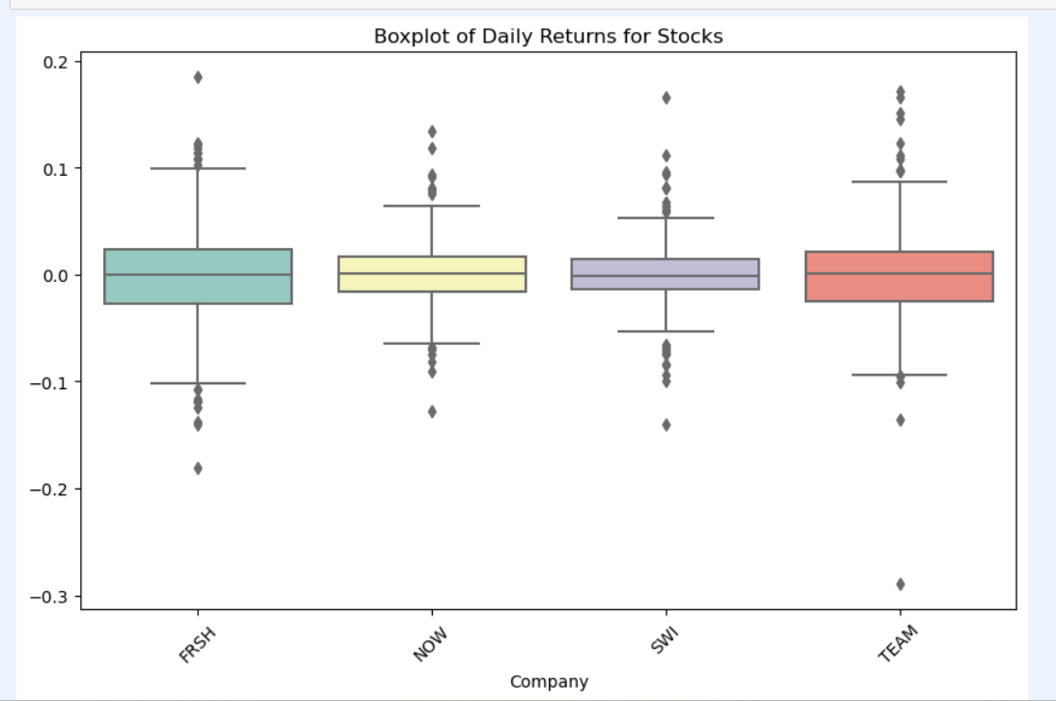
BOXPLOT
Overall, the boxplot suggests that FRSH is the most volatile stock, with the highest median return and the most variability in its daily returns.
SWI is the least volatile stock, with the lowest median return and the least variability in its daily returns. NOW and T have moderate volatility.

Slide 10
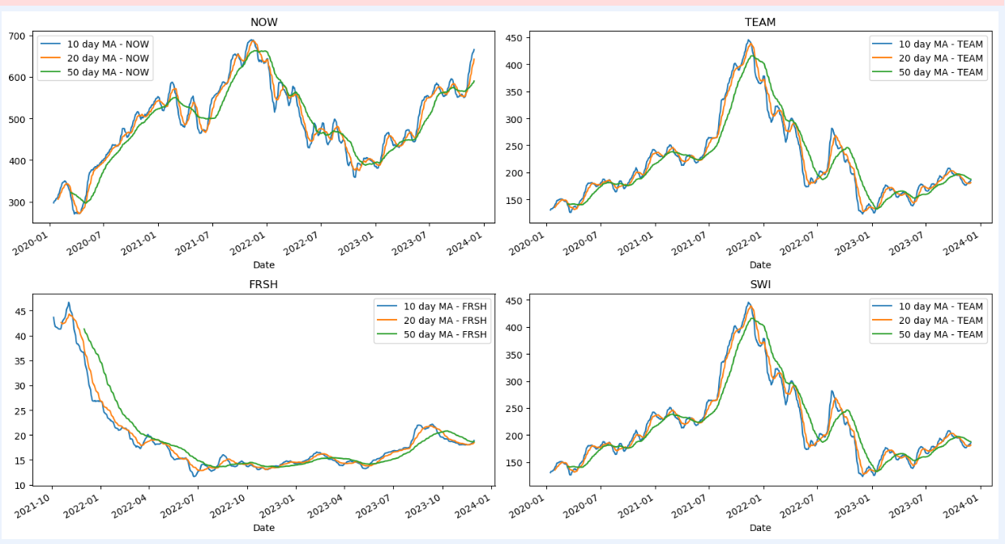
Moving Averages - NOW, TEAM, FRSH, SWI

Slide 11
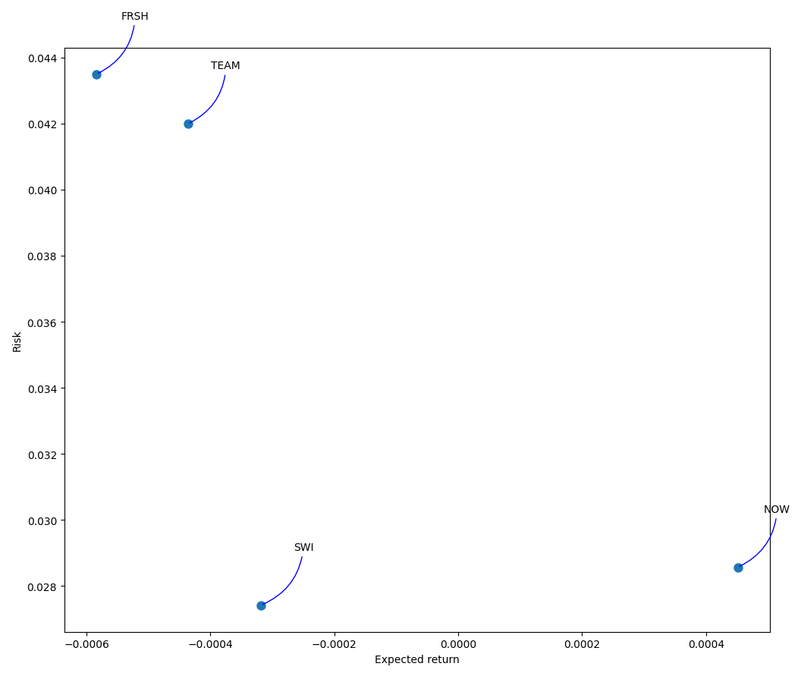
Risk Vs. Return - NOW & Competitors

Slide 12
Moving Average Strategy
Simple Moving Average
Exponential Moving Average

Slide 13
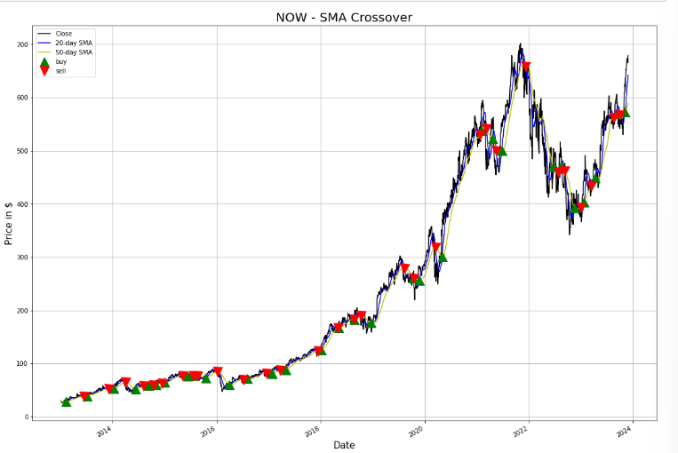
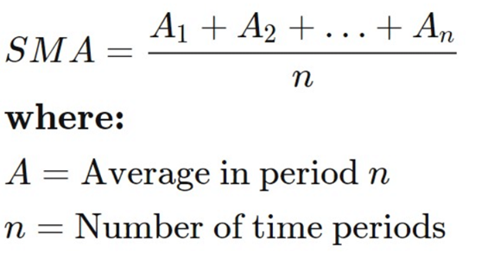
Simple Moving Average
SMA calculates the average price stock for a period without giving any preference to specific data​

Slide 14
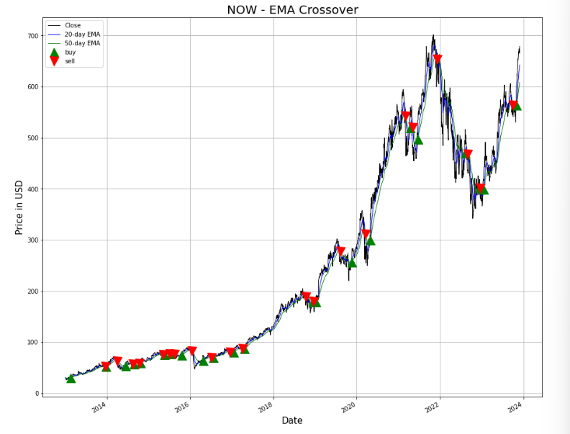
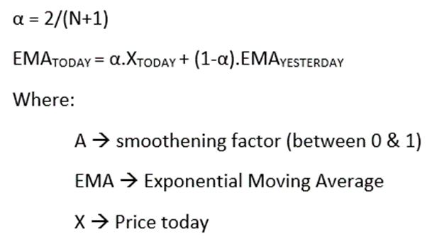
Exponential Moving Average
EMA calculates average giving more weight to current data; newest price has more impact compared to older price ​

Slide 15
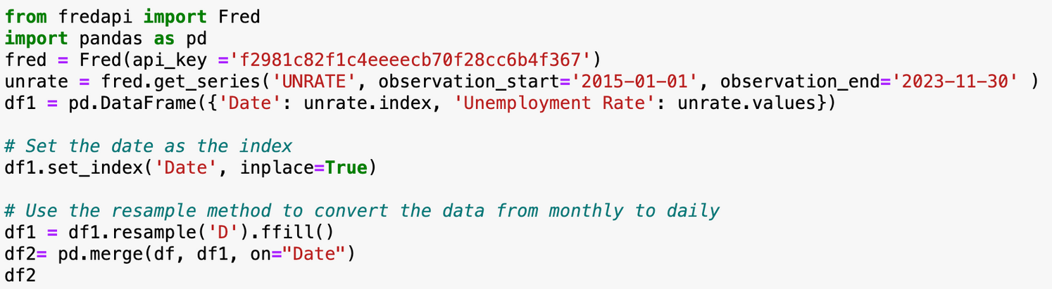
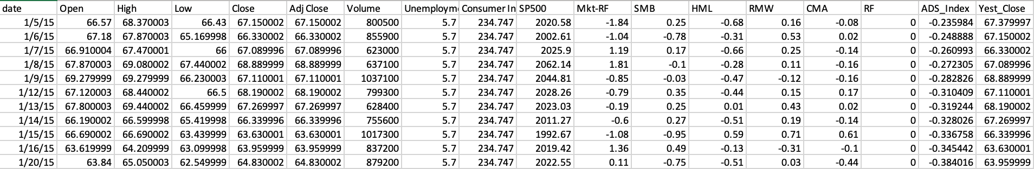
Initial stock data for "NOW" stock has been taken from yahoo finance library
Constructed Feature Database using Fred API, data from Fama French website and ADS
New features added are yest_close, HML, SMB, RF and Mkt-RF
Feature Database

Slide 16
Ridge
XGBoost
Feature Selection
Lasso
Random Forest
LARS

Slide 17
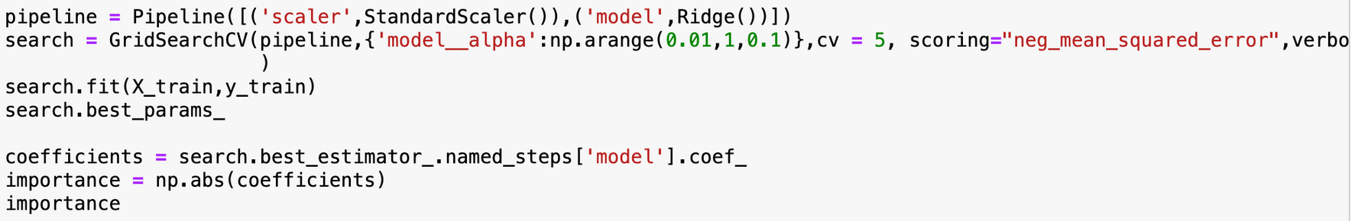
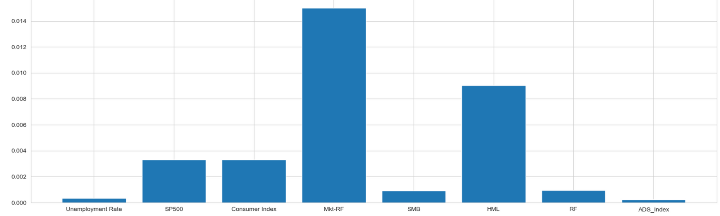
Ridge Regression

Slide 18
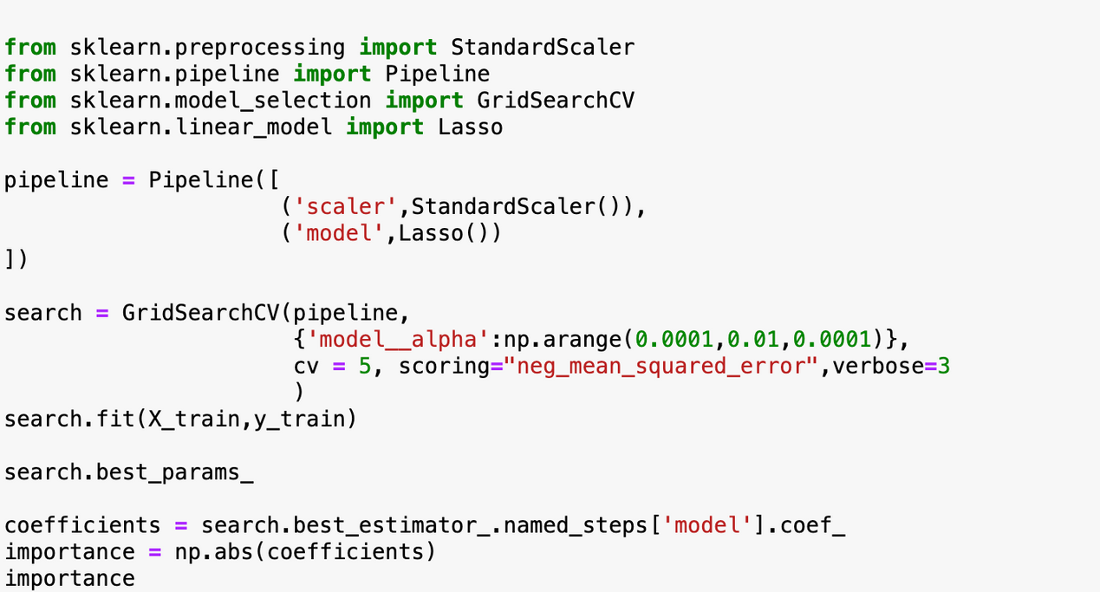
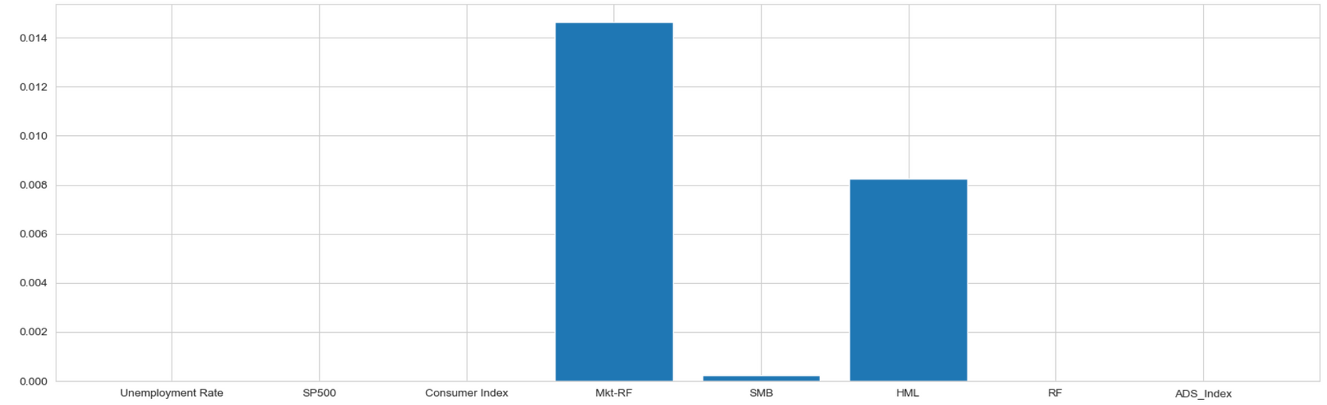
Lasso Regression

Slide 19
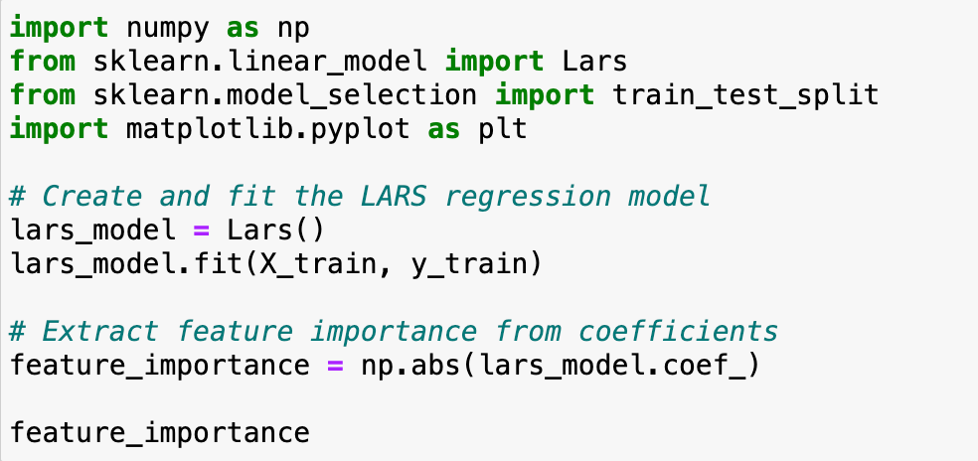
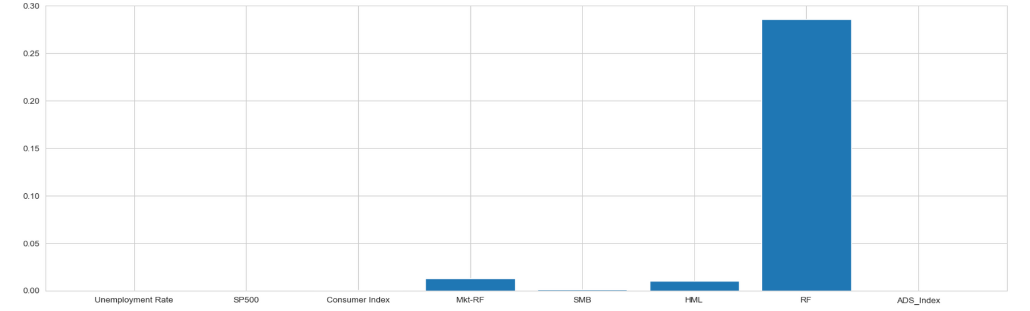
Least Angle Regression (LARS)

Slide 20
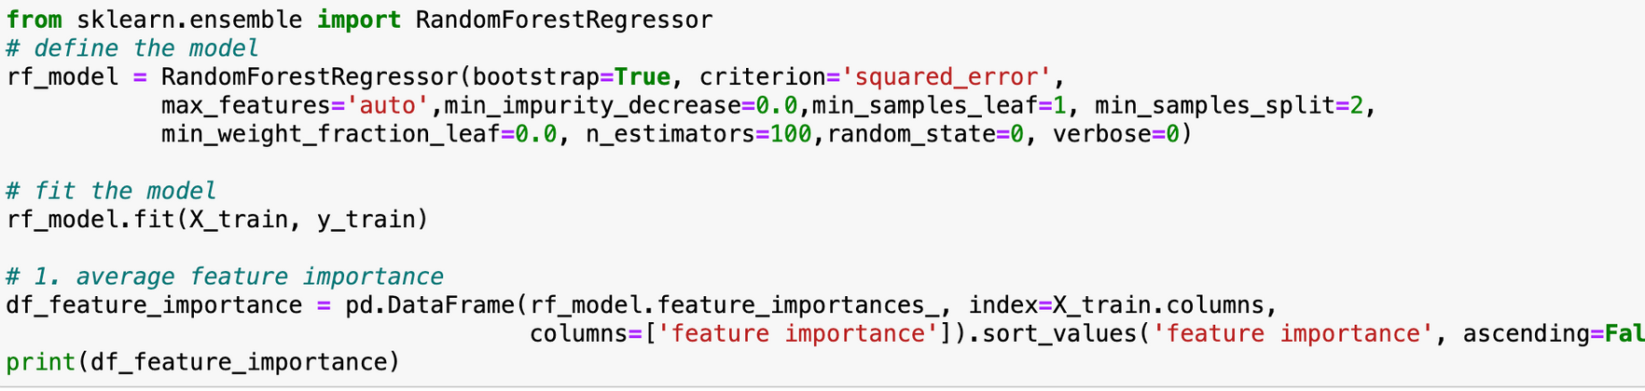
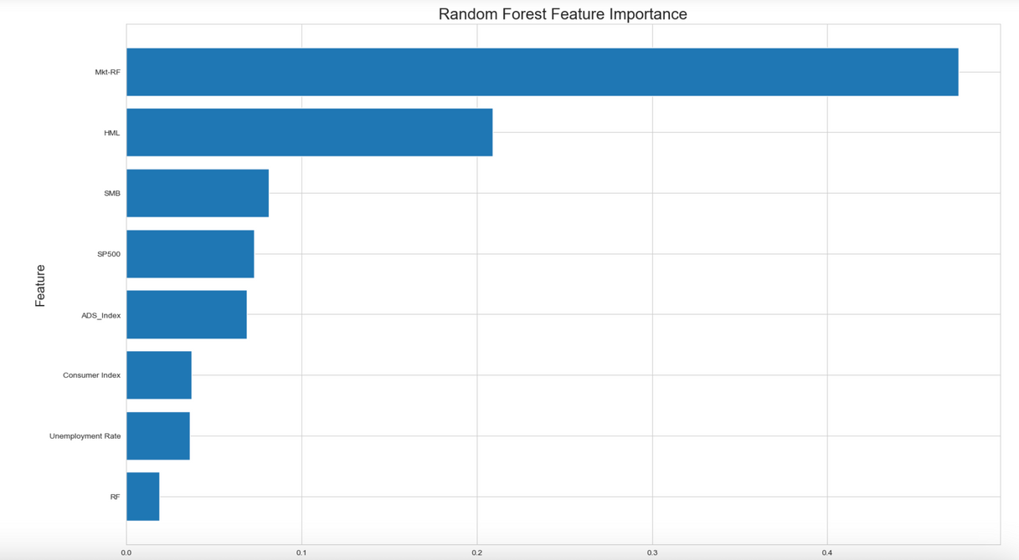
Random Forest

Slide 21
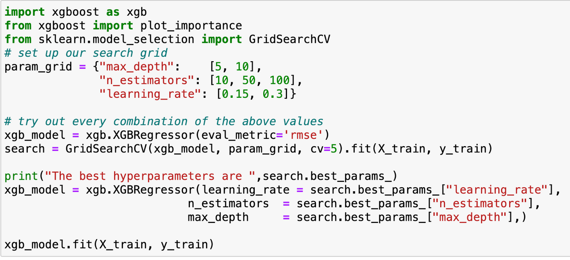
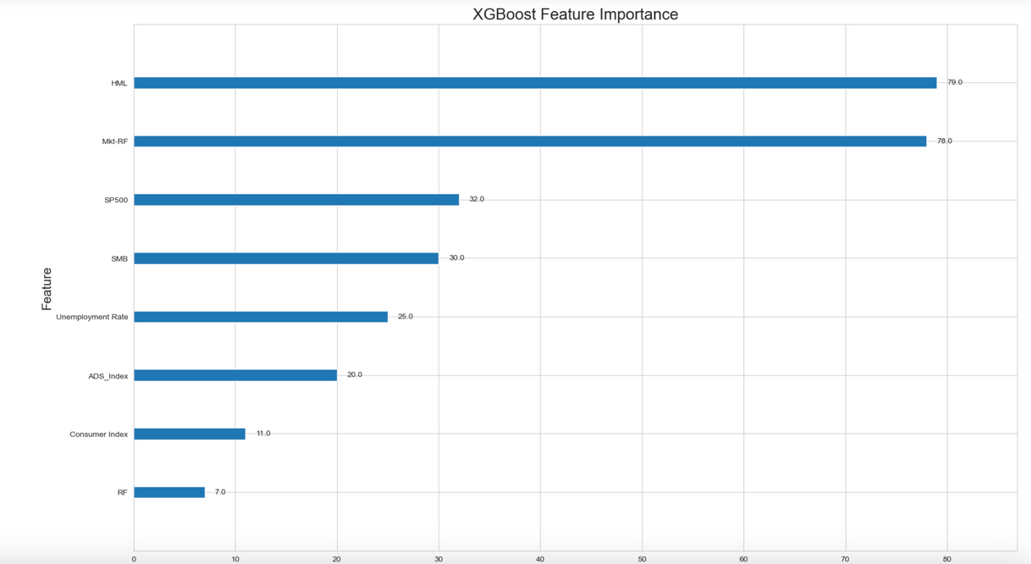
XGBoost

Slide 22

Feature Selection
MODEL | Features | Regression
Ridge | Mkt-RF HML | Regression
Lasso | Mkt-RF HML | Regression
LARS | RF | Regression
Random Forest | Mkt-RF HML | Decision Tree
XGBoost | HML Mkt-RF | Decision Tree

Slide 23
LSTM
XGBoost
Linear Regression
ML Models
Fama French 3
Random Forest
Gradient Boosting

Slide 24
Linear Regression: Identifies the linear relationships between a dependent variable and one or more independent variables.
Goal: Aims to minimize the differences between observed values and values predicted by the linear model.
Linear Regression
Utility: Useful in various fields for predictive modeling and data trends analysis.

Slide 25
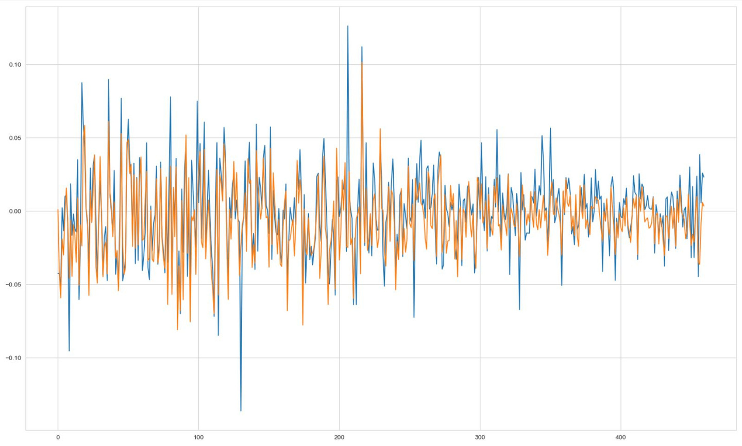
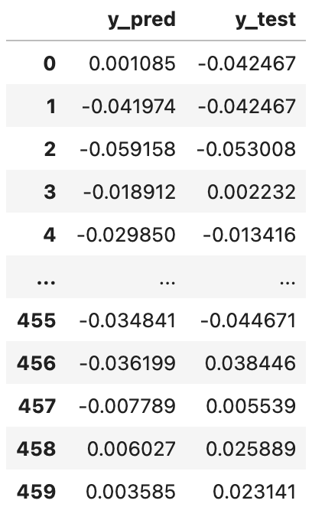
Linear Regression
RMSE: 0.01958
R2 score: 0.5601

Slide 26
Long Short-Term Memory (LSTM): An advanced type of recurrent neural network (RNN), specially designed for sequence data.
Long Short Term Memory (LSTM)
Purpose: Designed to overcome the vanishing gradient problem of standard RNNs
Unique Feature: Capable of maintaining and processing information over long time periods thanks to its specialized network architecture.

Slide 27
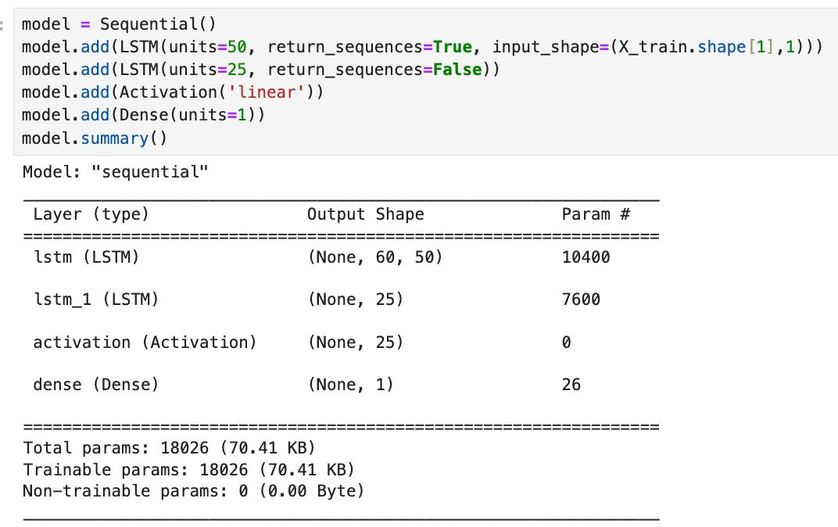
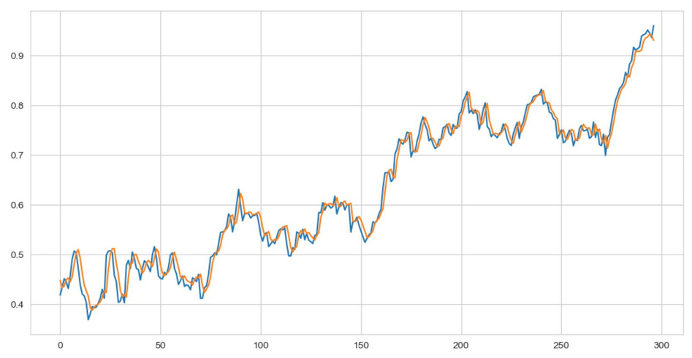
LSTM
RMSE: 0.02059
R-Squared Score = 0.9791

Slide 28
XGBoost: An optimized gradient boosting machine learning library.
XGBoost
How It Works: Builds multiple trees sequentially to correct previous errors, enhancing prediction accuracy.
Benefits: Known for speed, performance, and handling missing data effectively.

Slide 29
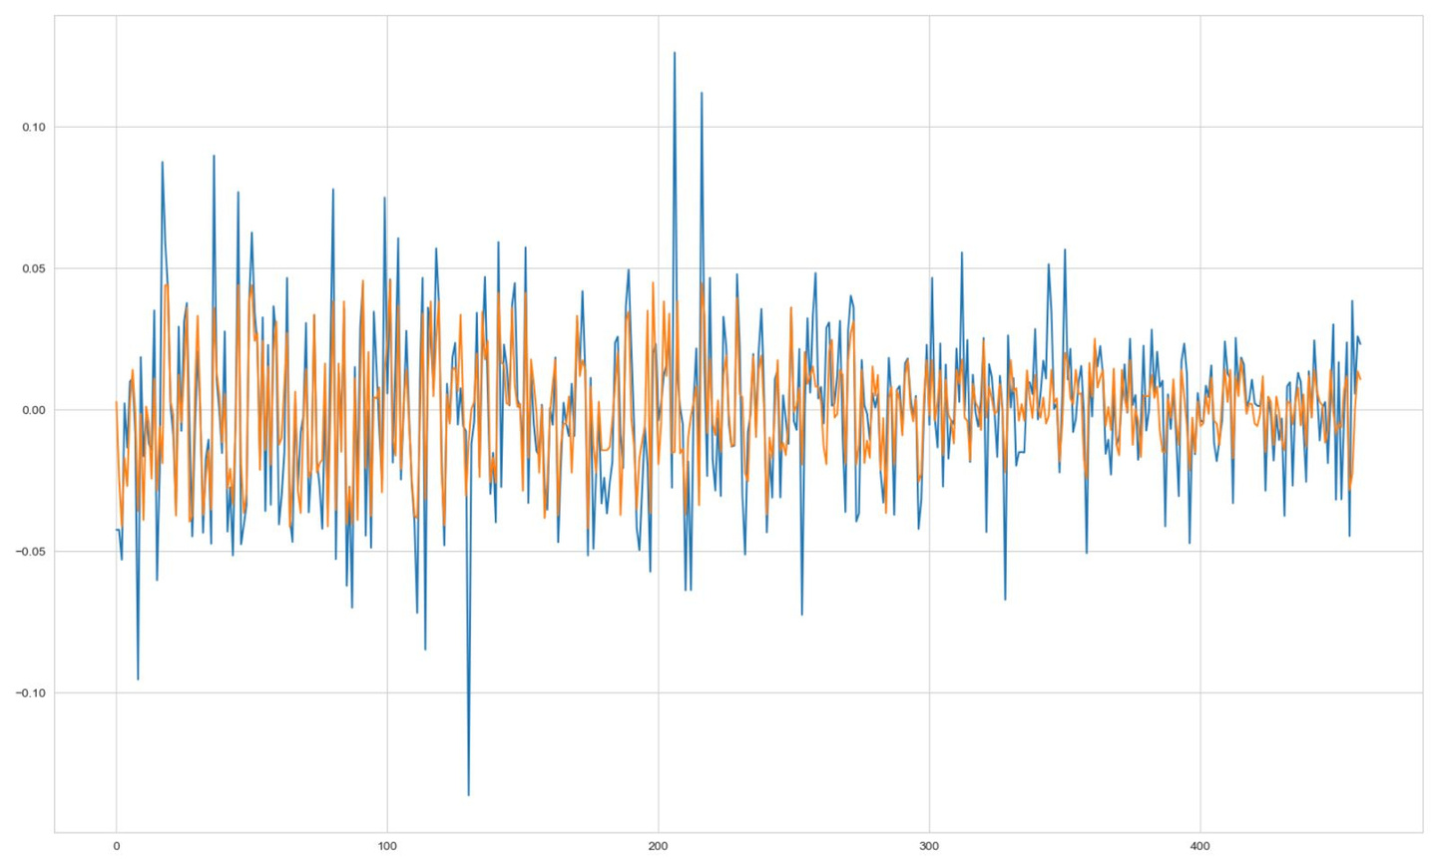
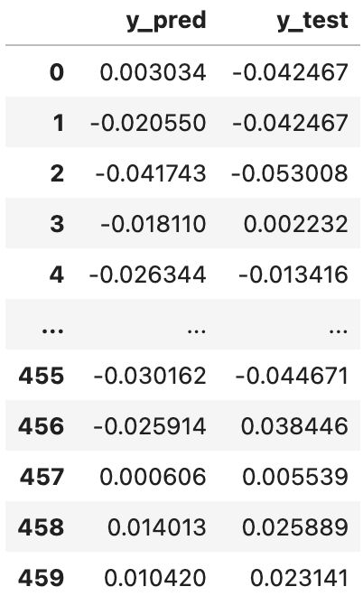
XGBoost
RMSE: 0.01977
R2 score: 0.5514

Slide 30
Random Forest: An ensemble learning method that operates by constructing a multitude of decision trees at training time.
Function: It outputs the mode of the classes (classification) or mean prediction (regression) of the individual trees for robust and accurate predictions.
Random Forest
Advantages: Effective in handling large data sets with higher dimensionality, provides estimates of feature importance, and mitigates overfitting.

Slide 31
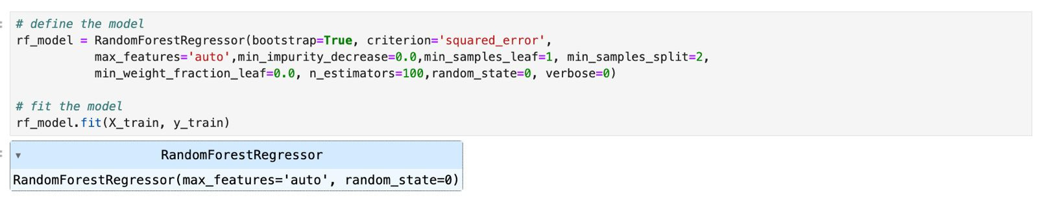
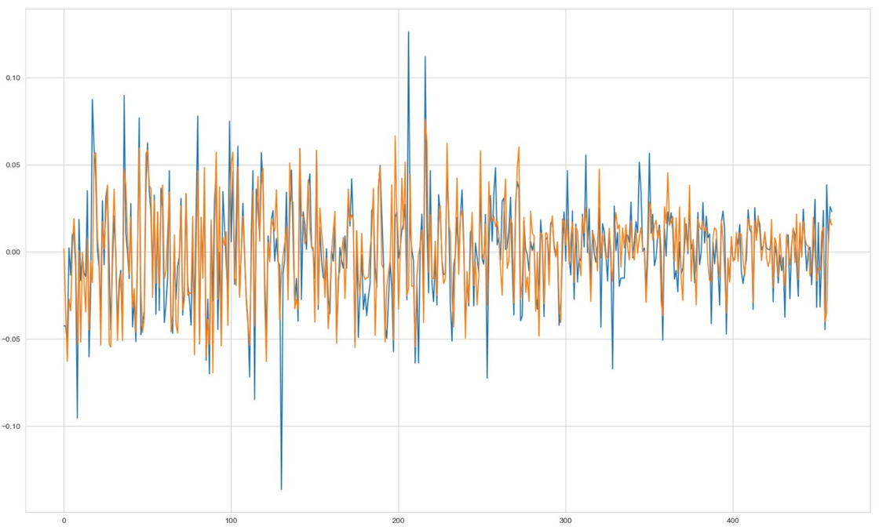
Random Forest
RMSE: 0.02042
R2 score: 0.7513

Slide 32
Fama French: Expands on the Capital Asset Pricing Model (CAPM) by adding two factors—size and value—to the market risk factor.
Objective: Aims to explain stock returns through three variables: market risk, the outperformance of small versus big companies, and the outperformance of high book-to-market value companies.
Fama French 3
Empirical Validation: Offers a deeper insight into portfolio performance.

Slide 33
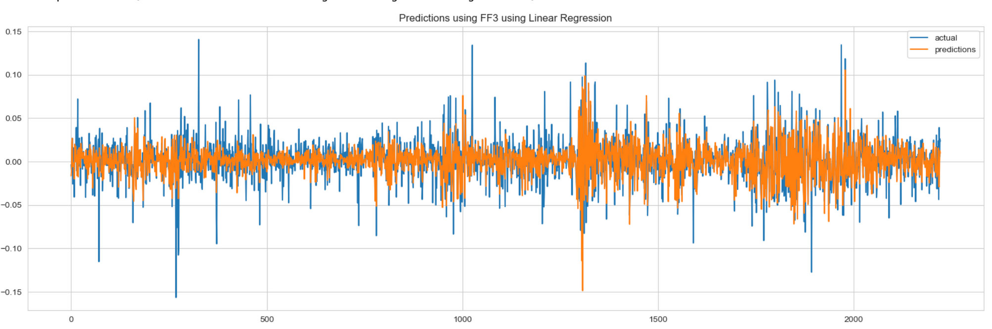
Fama French 3 Factor Model- Regression
RMSE: 0.01719
R-Squared: 0.6305

Slide 34
The FAMA and French Three Factor model underscores the importance of enduring heightened market fluctuations and occasional short-term setbacks.
Investors with a horizon of 15 years or more stand to gain from enduring short-term losses.
The key drivers of anticipated returns encompass market sensitivity, and value stock sensitivity gauged by the book-to-market ratio.
The model's three factors comprise of:
SMB (small minus big)
HML (high minus low)
Portfolio's return minus the risk-free rate
The formula for Fama French 3 is as follows:
Rit − Rft = αit + β1(RMt − Rft) + β2SMBt + β3HMLt + ϵit
where:
Rit = total return of a stock or portfolio i at time t
Rft​ = risk-free rate of return at time t
RMt ​= total market portfolio return at time t
Rit ​− Rft ​= expected excess return
RMt​−Rft​ = excess return on the market portfolio (index)
SMBt​ = size premium (small minus big)
HMLt​ = value premium (high minus low)
β1,2,3​ = factor coefficients​

Slide 35
Gradient Boosting: An ensemble of models that make no assumptions about the data, which are typically decision trees.
Gradient Boosting
Objective: Handles complex relationships between variables by capturing their non-linear relationships.
Pros: Provides valuable insights into feature importance, and their impact on long-term stock prices.

Slide 36
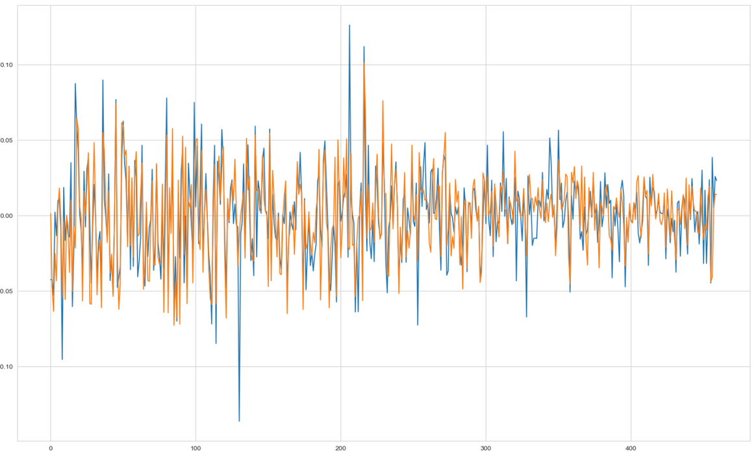
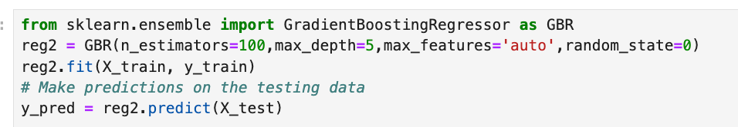
Gradient Boosting
RMSE: 0.02077
R-Squared: 0.6048

Slide 37
Model Performance
MODEL | RMSE | R-squared
Fama French 3 | 0.017 | 0.631
LSTM | 0.021 | 0.972
Linear Regression | 0.020 | 0.560
Gradient Boosting | 0.021 | 0.604
XGBoost | 0.019 | 0.551
Random Forest | 0.020 | 0.751

Slide 38
Benchmark
Study
Garch
Kalman Filter

Slide 39
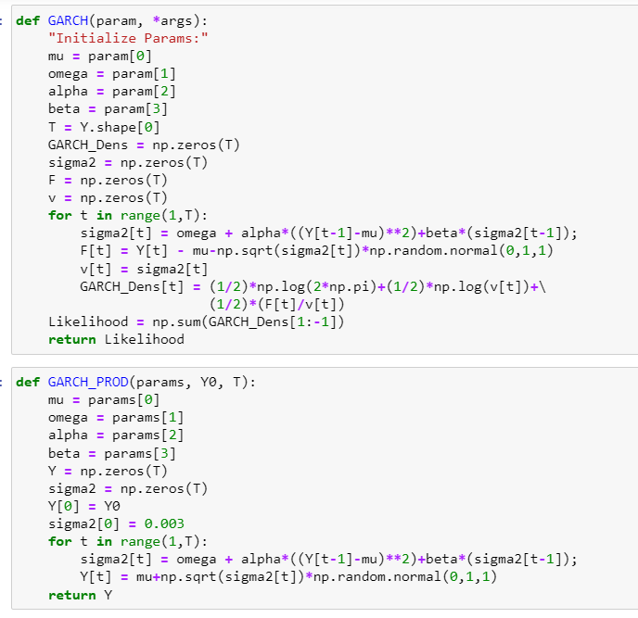
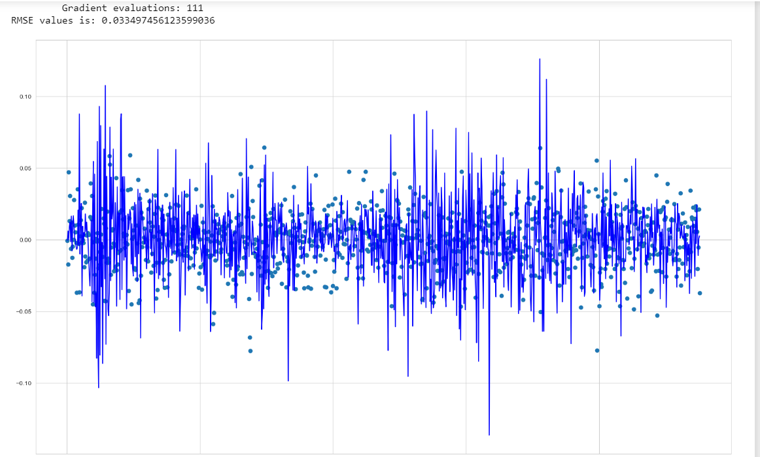
Garch Model

Slide 40
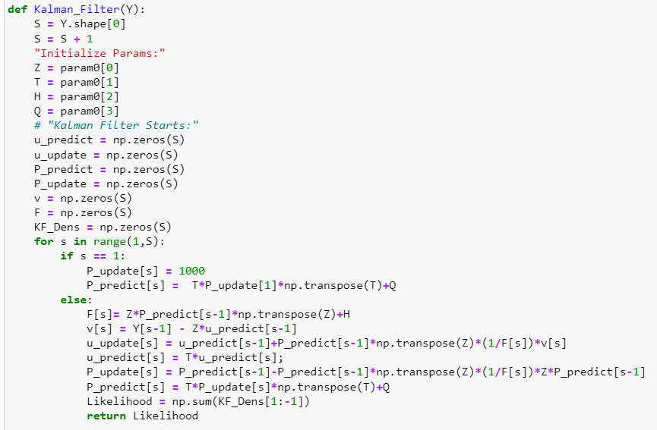
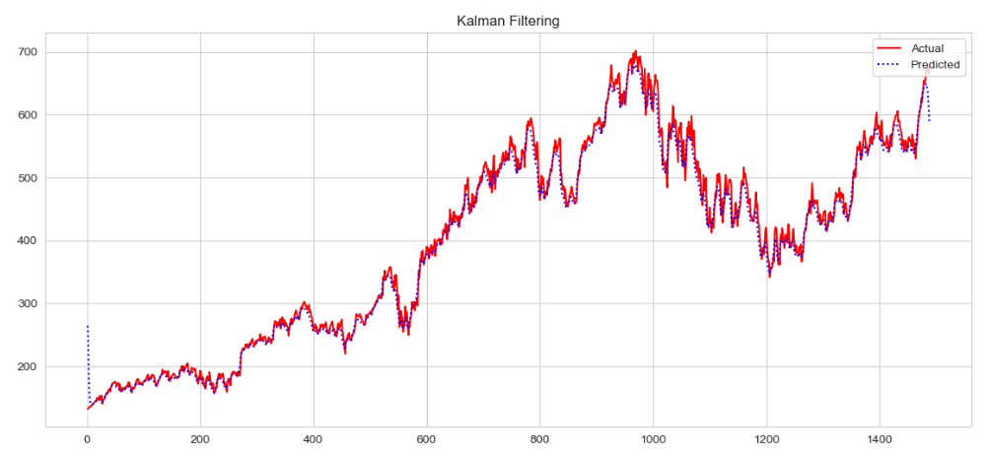
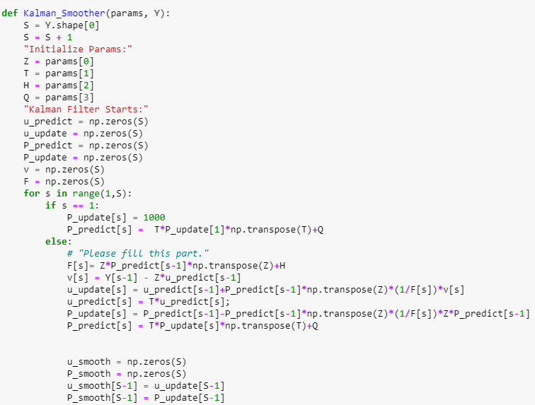
Kalman Filter Model

Slide 41
Trading
Strategies
Long/Short
Strategy
Buy/Hold
Strategy

Slide 42
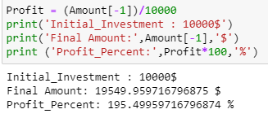
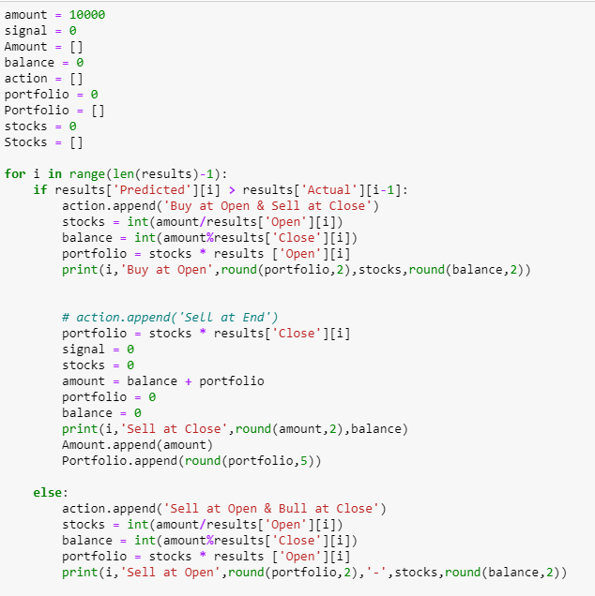
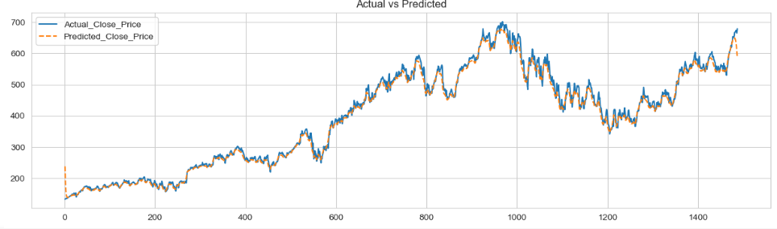
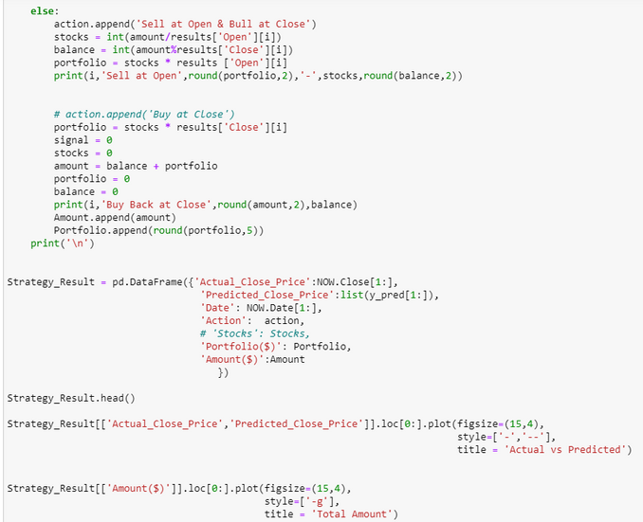
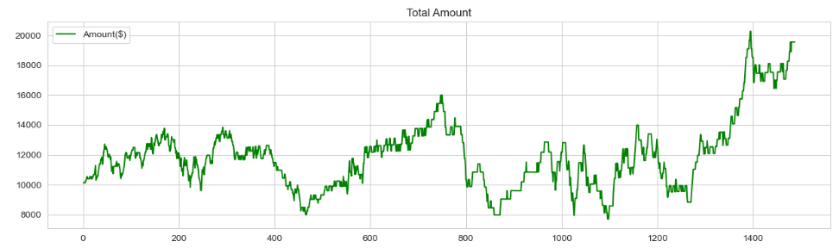
Kalman Filter Long/Short Strategy
if predicted > yesterdays close, buy and sell at end of day
if predicted < yesterdays close, sell and buy at end of day

Slide 43
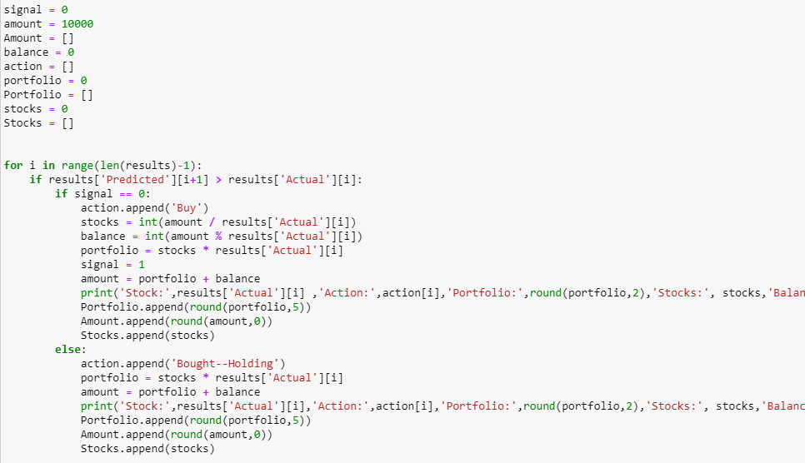
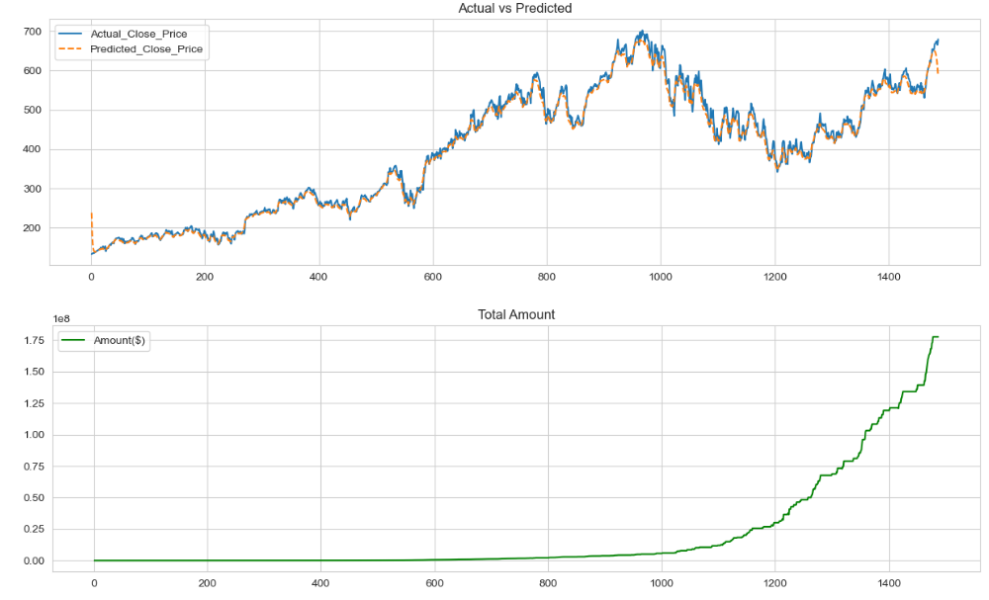


Kalman Filter Buy/Hold Trading Strategy
Position trading
Buy if we have next days predicted_value greater than todays close value and hold if already bought
Sell if we have next days predicted_value lesser than todays close value and dont buy until rule 1

Slide 44
Conclusion
1. Decision Tree Reigns Supreme: For feature selection, Decision Tree emerged as the clear champion, effectively identifying the most relevant data points for predicting ServiceNow's stock price.
2. Model Performance Powerhouse: The combination of Fama-French factors, LSTM networks, and Random Forests delivered the highest model accuracy, providing valuable insights into future stock movements.
3. Trading Strategies that Triumph: Long/short strategies and buy/hold approaches proved most effective in navigating ServiceNow's volatile market, allowing investors to capitalize on both upward and downward trends.

Slide 45
Thank You

